Slide 1
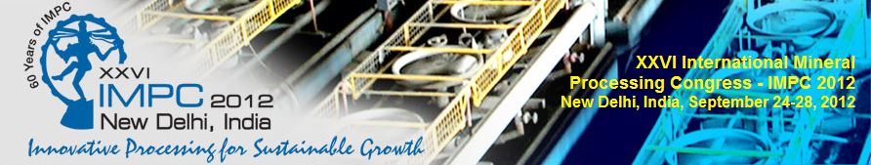





Combination of Ion Exchange and Solvent Extraction versus Solvent Extraction, a Technical–Economical Comparison
G. Savov , T. Angelov, Al.Tsekov - Iontech Engineering Ltd
I.Grigorova, I.Nishkov - University Of Mining and Geology “St.Ivan Rilski”
Special acknowledge for excellent technical and technological support to
supplier of the ionexchange resin applied in the works
supplier of the liquid extractant applied in the works
University of mining and geology “St. Ivan Rilski” for the collaboration
IONTECH ENGINEERING for the industrial adaptation of the process

Slide 2
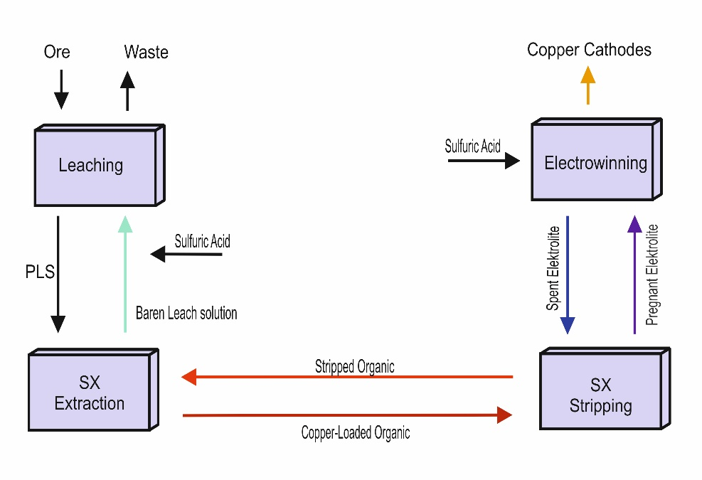
Motivation and Objectives
SX/EW process
  Well-known technique, used commercially from more than 40 years
  Advantages - low temperature, recycling of barren solutions, high selectivity, final commercial product
  Some shortcomings that have several negative impacts.
Shortcomings of the SX process
Solids in the Leach Solution - caused crud generation and thus reduced of flow capacity of the plant and occasionally caused a plant shutdown.
Complexity chemical composition of Leach Solution disturb dramatically transfer and may cause destruction of the extraktant.
Chemicals used in solid liquid separation – flocculants and coagulants may gives lots of sticky crud that may float and move or it may form a gelatinous mass that is very difficult to remove and treat
Variable Copper Concentration in Pregnant Leach Solution will impact production and selectivity
Temperatures of PLS before entering into SX is very critical concerning operating parameters such as phase disengagement, thus affected on production rate and selectivity.

Slide 3
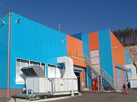
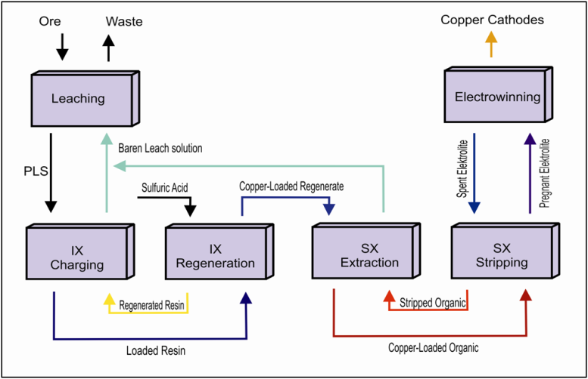
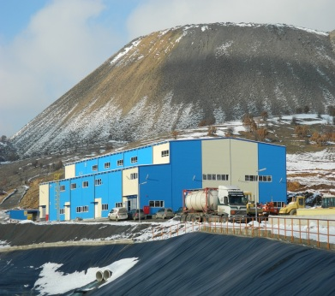
Developped Process
IX/SX/EW process
  IX is widely used mostly in water treatment and metal recovery from low content solutions
  Combination of Ion Exchange, Solvent Extraction and Electrowinning for the recovery of copper from AMD and low quality PLS
  Simple, energy efficient, environmentally friendly and with high recovery efficiency of the copper
Advantages of combining IX/SX
May work solutions with metal concentrations, varying on a broad range as well as for treatment of solutions in the decommissioning of spent copper dumps, acid mine drainage /AMD/ and ammonia etch solutions;
Operation with very low-graded copper pregnant leach solutions – starting from 1,5 to 0,1 g/l copper
Reducing of large ponds for pre-filtration of the PLS
Properly work at intensive rainfalls and with turbid solutions and containing large quantities of suspended solids;
Winter operation of facilities without troubles;
Strongly reduces organic losses and crud formation;

Slide 4

Industrial
applications
Asarel
L/SX/EW
copper project
Buchim
L/IX/SX/EW
copper project
Process | Operation plant data parameter | Asarel | Bucim
Leaching | Almost identical technical and operational parameters
IX | Flow rate of PLS to ion exchange facility | NA | 648 m³/h
 | First fill ion exchange resin | NA | 80 m³
 | Consumption of ion exchange resin | NA | 7 m³/year
 | Production of concentrated copper regenerant (CCR) | NA | 40 m³/h
SX | Flow rate of PLS(CCR) to SX facility | 422 m³/h | 40 m³/h
 | First fill SX diluent | 440 m³ | 60m³
 | Consumption of SX diluent | 140 m³/year | 38 m³/year
 | First fill SX extractant | 40 m³ | 15m³
 | Consumption of SX extractant | 10 m³/year | 4m³/year
EW | Almost identical technical and operational parameters
Overall | Maximal Copper cathodes production | 2000 tpy | 2400 tpy
 | Buildings | 3000 m² | 1500 m²

Slide 5
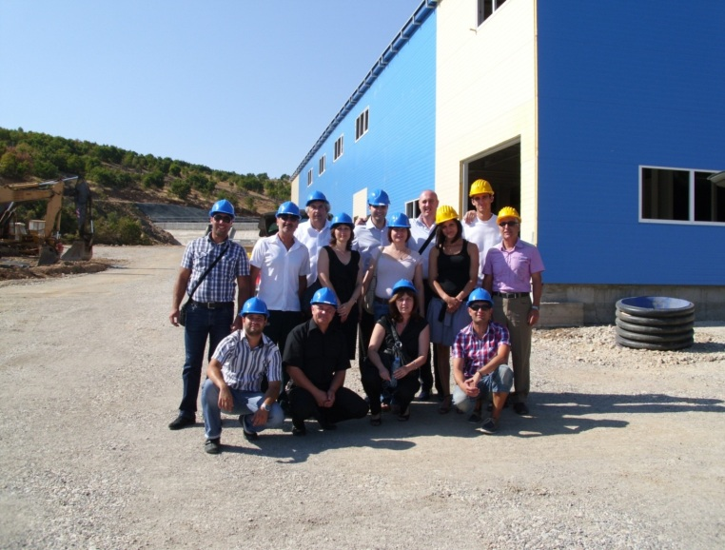
Summary and Conclusions
The paper has briefly described the application and key findings of a novel hydrometallurgical process, which uses combination of Leaching, Ion Exchange, Solvent Extraction and Electrowinning for the recovery of copper from AMD and low quality PLS.
The process described is simple, energy efficient, environmentally friendly and with high recovery efficiency of the copper.
It was applied industrially proven equipment and facility disposition.
The project design decided operational management of Pregnant Leaching Solutions, Acidic Mine Drainage coming from old dumps and other contaminated water in the mining area.
Project is designed with proven economical effect for copper recovery, both from old dump, and new mined oxide copper ore, which is unsuitable for conventional flotation treatment.
Iontech Engineering ltd.
BULGARIA, 1113 SOFIA,
20 “Fr. Joliot Curie” street
Tel: +35928164431
e-mail: office@iontech.bg
www.iontech.bg
For detailed information and questions please revert to the poster session and contacts details of authors.
Thank you for your attention !!!

